Slide 1
HSI portfolio
Pulse Results
January 2026

Slide 2
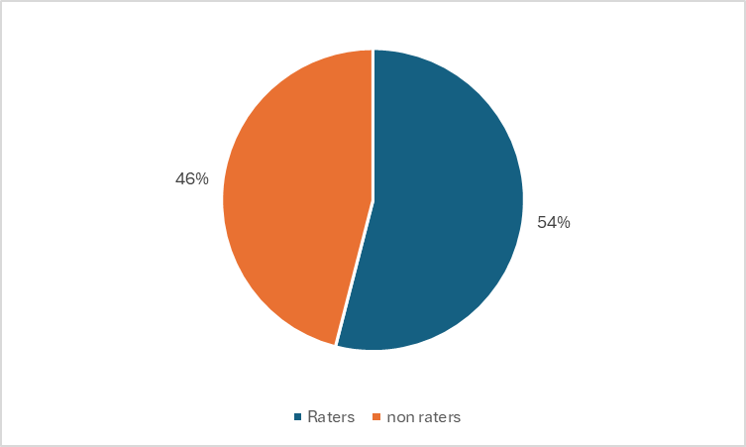

Slide 3
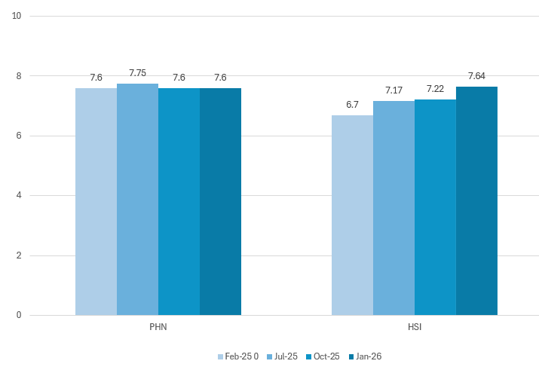
I would recommend BNPHN as a place to work.
(Scale 0 = would not recommend – 10 = extremely likely to recommend)

Slide 4
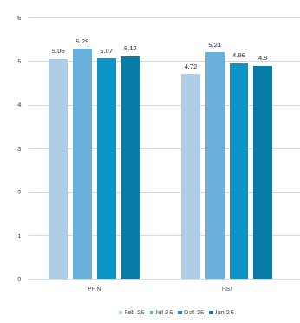
I understand what is expected of me and how I fit in with the bigger outcomes for BNPHN.
(Scale 1 = I do not understand what is expected of me and how I fit with the bigger picture
6 = I completely understand what is expected of me and how I fit with the bigger picture)

Slide 5
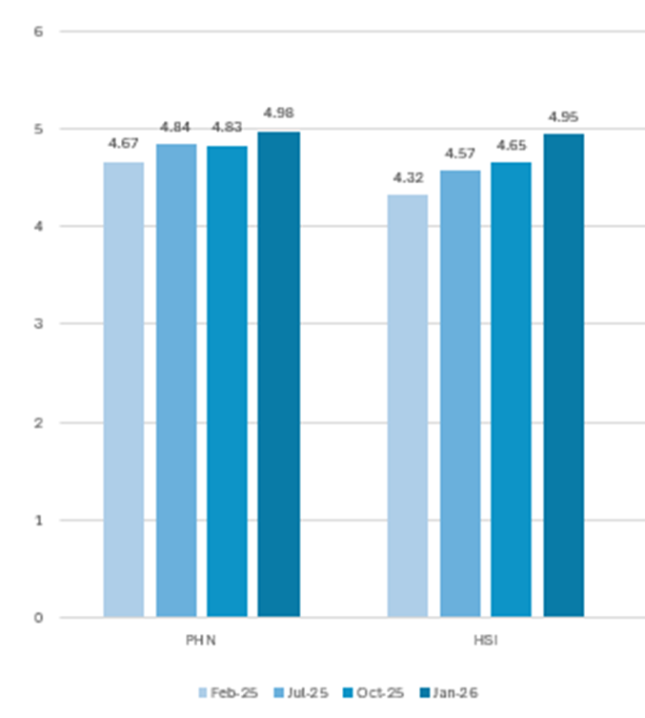
I have the resources to achieve my performance targets.
(Scale 1 = I do not have any of the resources I need to achieve my performance targets
6 = I have all the resources I need to achieve my performance targets)

Slide 6
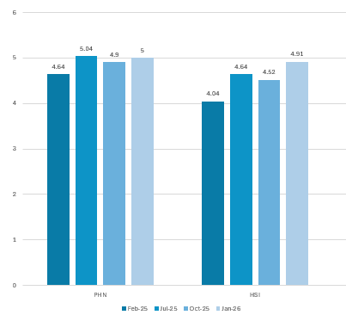
I have a strong sense of belonging with my team.
(Scale 1 = I do not feel a sense of belonging with my team
6 = I have a very strong sense of belonging with my team)

Slide 7
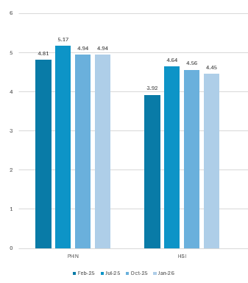
The person I report to provides the required guidance and leadership for my role.
(Scale 1 = I do not receive guidance and support from the person I report to
6 = I receive all the guidance and support I need for my role)

Slide 8
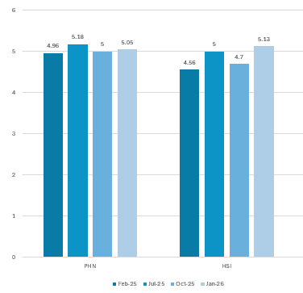
I feel an alignment with our future targets and I am motivated to achieve them.
(Scale 1 = I do not align and am unmotivated
6 = I have strong alignment and motivation with future targets)

Slide 9
Area Comments - positive
Thank you for the work flexibility and being part of a great culture
I love working at the PHN!
I love the people at the PHN and I love that we can have a laugh along the way
Appreciate our leadership and feel we are well placed for a good 2026.
  CEO - leadership and transparency.
  Executive Manager – a great advocate for our team who has supported a lot of change and complexity. Demonstrates a calmness that is very steadying and also knows how to lighten things up. Appreciate her capacity to be across so much detail. It gives our team great confidence to know she is steering the ship.
  Manager l Primary Care – leads with compassion and fresh ideas and creates a safe, inclusive environment where everyone feels valued.
It's a pleasure working with such passionate, talented people. I feel well looked after, heard and thoroughly enjoy my role.
The recent positive changes - I value my team. I acknowledge and appreciate that my manager and team leader are listening to individuals in the team to look at what changes might be needed to become an even better team.
Appreciate not being micromanaged and that I am allowed the opportunity to work within reason to my own schedule.
I am very self-motivated to achieve outcomes but always happy to share and work collaboratively.

Slide 10
Area Comments – for improvement
For better work/life balance, 1 day mandatory working from office would be better with the second day optional/encouraged
I did not get an adequate induction into my program/portfolios when I first started which made my experience in the first weeks and months quite challenging
At times, feel some of the ways we are spending parts of our funding could arguably be defined as wasteful. While I understand we have to invest in our people and it's important to do things to contribute to staff wellbeing and encourage team work and collegiality, I think we taken it too far at times. Examples:
  All Staff Xmas lunch + individual team functions + Working Group functions.
  Amount of time spent by our office move Working Groups on all the many updates etc.

