Slide 1
HSI portfolio
Pulse Results
October 2025

Slide 2
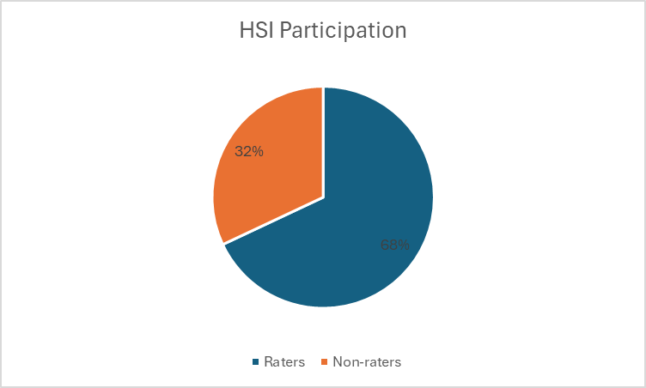

Slide 3
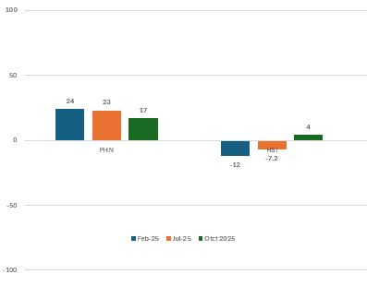
Employee Net Promoter Score (eNPS)
Above 50 considered “excellent”
Above 0 considered “acceptable”
Above 10 considered “good”

Slide 4
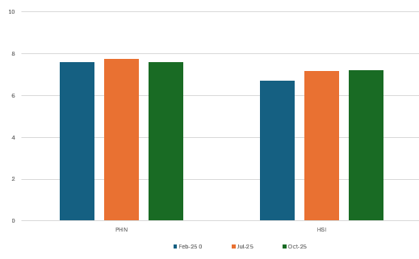
I would recommend BNPHN as a place to work.
(Scale 0 = would not recommend – 10 = extremely likely to recommend)

Slide 5
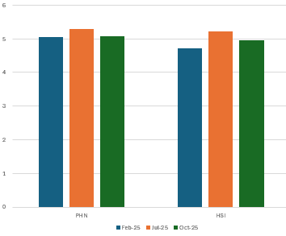
I understand what is expected of me and how I fit in with the bigger outcomes for BNPHN.
(Scale 1 = I do not understand what is expected of me and how I fit with the bigger picture
6 = I completely understand what is expected of me and how I fit with the bigger picture)

Slide 6
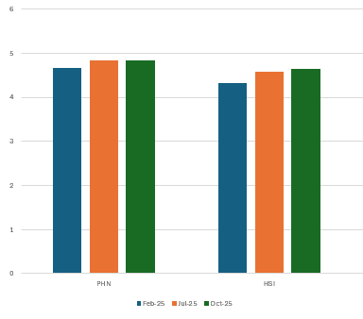
I have the resources to achieve my performance targets.
(Scale 1 = I do not have any of the resources I need to achieve my performance targets
6 = I have all the resources I need to achieve my performance targets)

Slide 7
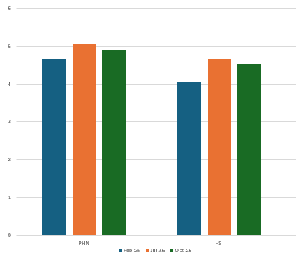
I have a strong sense of belonging with my team.
(Scale 1 = I do not feel a sense of belonging with my team
6 = I have a very strong sense of belonging with my team)

Slide 8
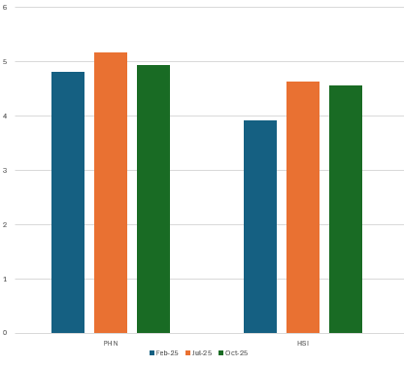
The person I report to provides the required guidance and leadership for my role.
(Scale 1 = I do not receive guidance and support from the person I report to
6 = I receive all the guidance and support I need for my role)

Slide 9
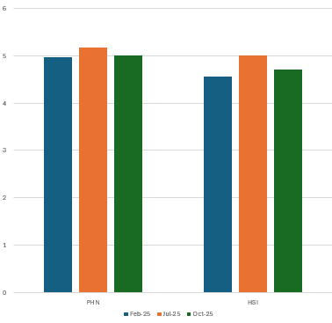
I feel an alignment with our future targets and I am motivated to achieve them.
(Scale 1 = I do not align and am unmotivated
6 = I have strong alignment and motivation with future targets)

Slide 10
Change management feedback around the office move - positives
A culture of trust has grown stronger as leaders have communicated decisions openly and invited staff to contribute their perspectives.
Having been through two relocations at my last place of work, I'm finding the management of the BNPHN move really transparent, well organised & communicated. It's been easy to find out details for some of the less talked about things, such as when the Coles account might be closed.
I think the change management process has been executed quite well. It would have been good for additional options for feedback, especially regarding the layout, but I think it has been carried out effectively, especially given the short timeframe
There has been obvious transparency, prompt updates, communication, as well as consultation where required, and good use of champions/leaders.
Staff have been consulted and updated throughout the entire process. Multiple opportunities for staff to provide feedback are available and support is being provide to those that need it (i.e. people needing support with public transport). Very appreciative of the organization’s efforts so far.
I feel informed and engaged in the process. Transparency is important and the FAQs and regular meetings have helped. If the PHN doesn't know the answer to a staff question, the question is addressed in a timely manner and communicated.

Slide 11
Change management feedback around the office move – positives
The executive team have communicated regularly with staff and have been very transparent. Provided opportunities to ask questions, been clear about what we don't yet know. Set up effective working group. Identified a Project Lead that is doing a fantastic job of coordinating such a huge task. Well done to everyone involved!
Great delivery by Project Lead - her presentation was perfect - giving the right amount of information, yet ensuring we don't get bogged down.
I rated the change management as excellent because the PHN working groups and Exec have consistently responded to any office relocation queries, actively sought feedback, and ensured staff are well-informed. Thank you for your efforts in ensuring everyone stays up to date!
It was done well and we have been actively involved.
There has been lots of commination and transparency, opportunities for Q & A's and individual circumstances are considered and supported - although it's been made clear that decisions ultimately must be made for best business case
Clear communication with people receiving the same information at the same time.
Regular updates and communication have been appreciated. Thanks for everything.

Slide 12
Change management feedback around the office move – positives
The executive team have communicated regularly with staff and have been very transparent. Provided opportunities to ask questions, been clear about what we don't yet know. Set up effective working group. Identified a Project Lead that is doing a fantastic job of coordinating such a huge task. Well done to everyone involved!
Great delivery by Debbie. Her presentation was perfect - giving the right amount of information, yet ensuring we don't get bogged down.
I think there was more than enough "consulting", I think we are at an "inform" stage, and ongoing communication when we have more information will be fine/enough.
The change management was well done overall
Great feedback and progress reports. I feel included in decision making.

Slide 13
Change management feedback around the office move – for improvement
The only thing I think could have been improved is it seems the working groups membership has been decided for us. Initially we were told there will working groups and people will have an opportunity to get involved, and I was looking forward to get stuck in, but there was no invitation for each of the groups. This is a minor thing.
I do feel like we should just get on with it now. Furniture, video updates are not needed. Perhaps, we could have an org open day when the new space is ready. Everyone comes into the office for wine trolley.
I think there are a lot of bureaucratic barriers that make it difficult to get jobs done efficiently and quickly.
The company car should have been sold via an open bidding process, rather than emailing aimlessly when you might already have been outbid and wasting your time.

Slide 14
Area Comments - positive
Good Managers make all the difference.
Thank you for making the PHN a great place to work.
Brisbane North PHN is truly a fantastic place to work and I very grateful for how the organisation has evolved and adopted a new and supportive culture.
I value the flexibility we have and the fact that most our staff are approachable, supportive and caring.
The flexibility regarding WFH is excellent; it’s helping our family considerably that I can WFH 3 days a week.
I feel heard when I raise issues that concern me or have innovative ideas and can see my concerns/ideas result in positive change (e.g. change in a process or adoption of a new resource).
There is an overall welcoming atmosphere, which is wonderful. Communication is excellent across the organisation.
The regular wellbeing events are fantastic - there are not many organisations that have monthly birthday cake sessions, wine trolley etc.

Slide 15
Area Comments - for improvement
Important for our managers/team leaders to grow their leadership skills and have personable skills. To encourage a positive, inclusive culture, it is important that our leaders connect and build respectful and professional relationships with their whole team rather than selected members. This will improve team morale.
It is important to have more clarity and direction for new bodies of work being requested and for leaders to walk alongside team members on this journey.
Team culture would benefit from individual team members demonstrating a more positive attitude and growth mindset - approaching new ideas and learning resources with curiosity.
The recent redeployment process was challenging for our team.
Consider increasing flexibility with WFH. Many similar jobs available that are fully remote or 1 day in the office. One day mandatory, additional day optional would be ideal.
Feel like there are too many planning days across own team + HSI days + staff development days! Suggest team planning days should be scaled back.
The survey questions don't accurately capture how I feel about the organisation. There are no questions in relation to workload and capacity, colleagues and there is no opportunity to provide feedback about the team or executive managers (only person I directly report to).

